Slide 1
Cyclistic users, 2019
Presented by: Rehaan Hasan Ansari
Last updated: 26-10-2026

Slide 2
Content
Objective.
Analysis.
Conclusion.

Slide 3
Objective
Understanding how casual riders and members use Cyclistic bikes differently, with the goal of developing a marketing campaign that converts casual riders into members.

Slide 4
analysis
Cyclistic users, 2019

Slide 5
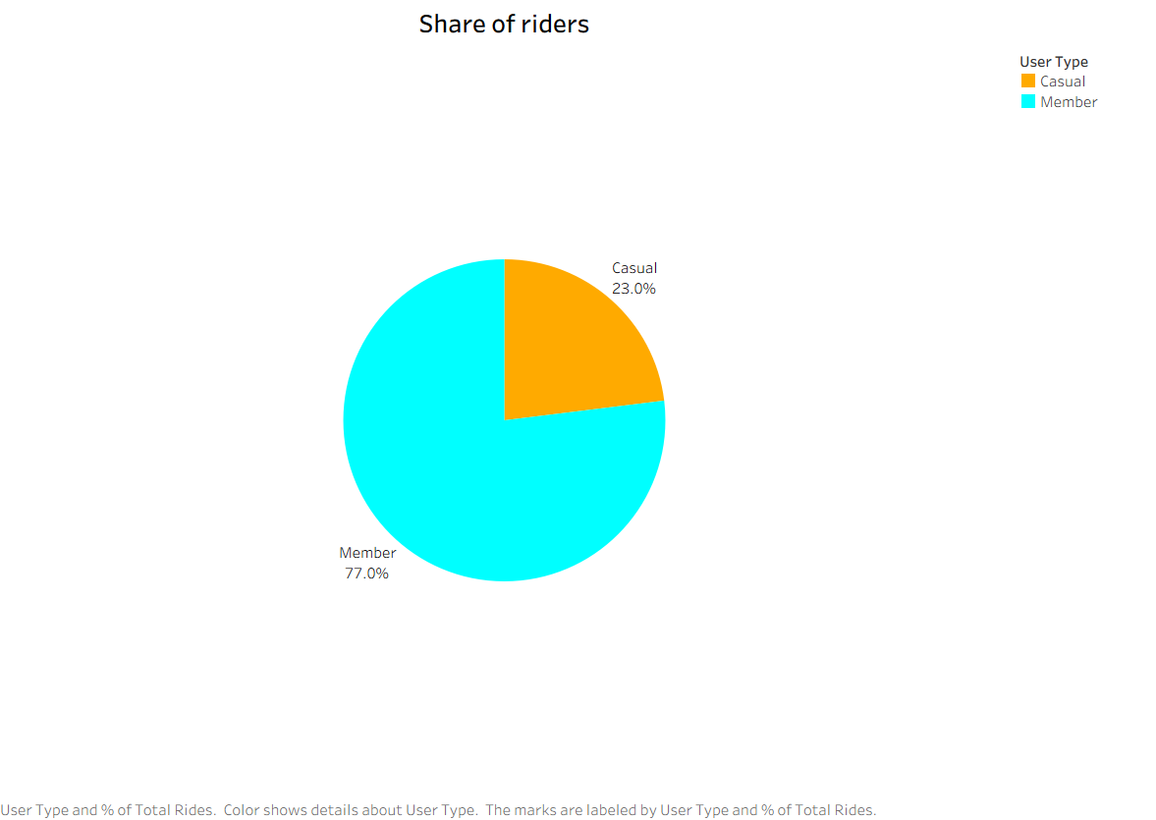
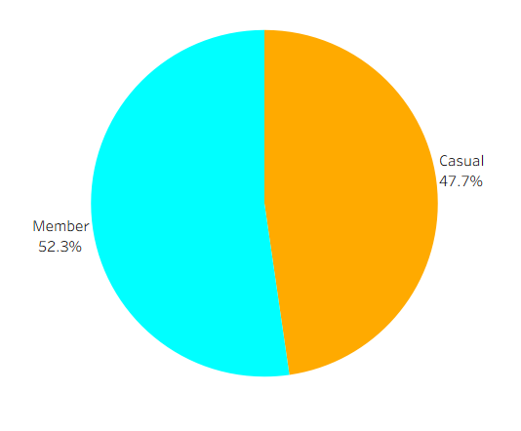

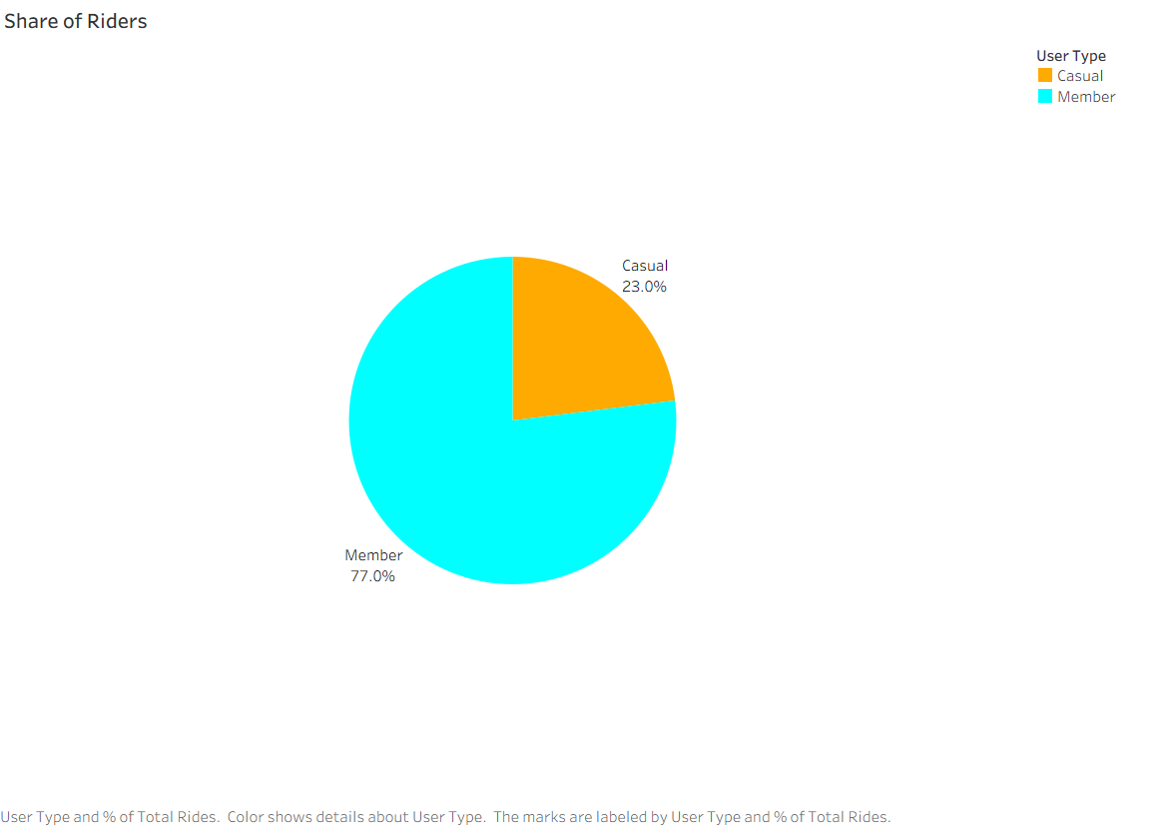
Share of rides
Casual riders take just 23% of rides, yet account for nearly half (48%) of all ride time. This is due to casual riders rides being 3 times longer than members on average.
This pattern suggests that member may use the Cyclistic bikes for everyday transport and casual riders use it for long rides.

Slide 6
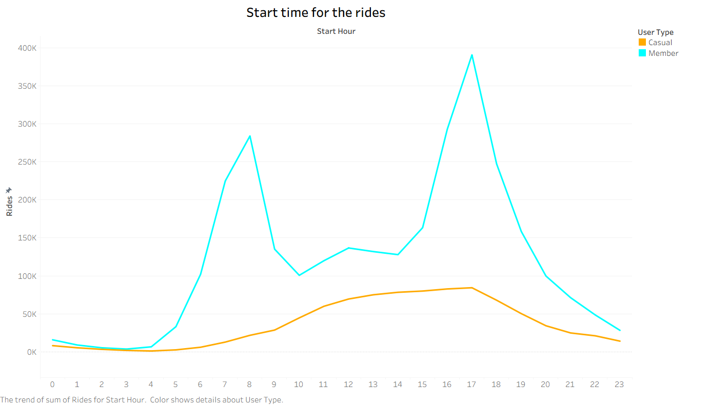
Start time for rides
Members rides peak around 8 AM and 5 PM, suggesting a possible commuting pattern.
Casual rides increase gradually throughout the day and peak in the late afternoon.
There is no peak during 8am for casual riders. So possibly most of them don’t use Cyclist bikes to commute to work but they do use them after the working hours.

Slide 7
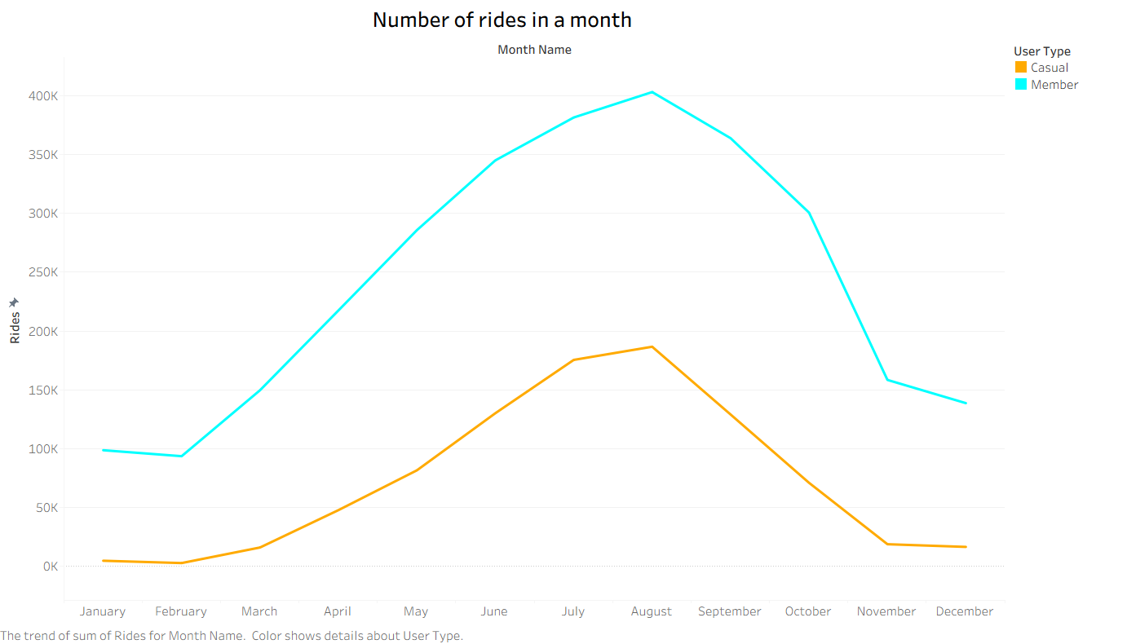
Number of rides in months
Both type of users show a similar seasonal pattern in ride volume.
Demand is highest during the summer and lowest during the winter.

Slide 8
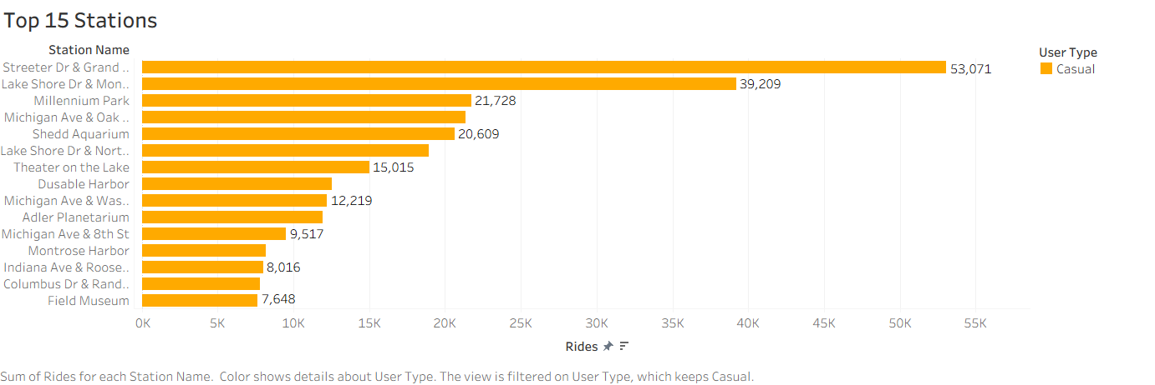
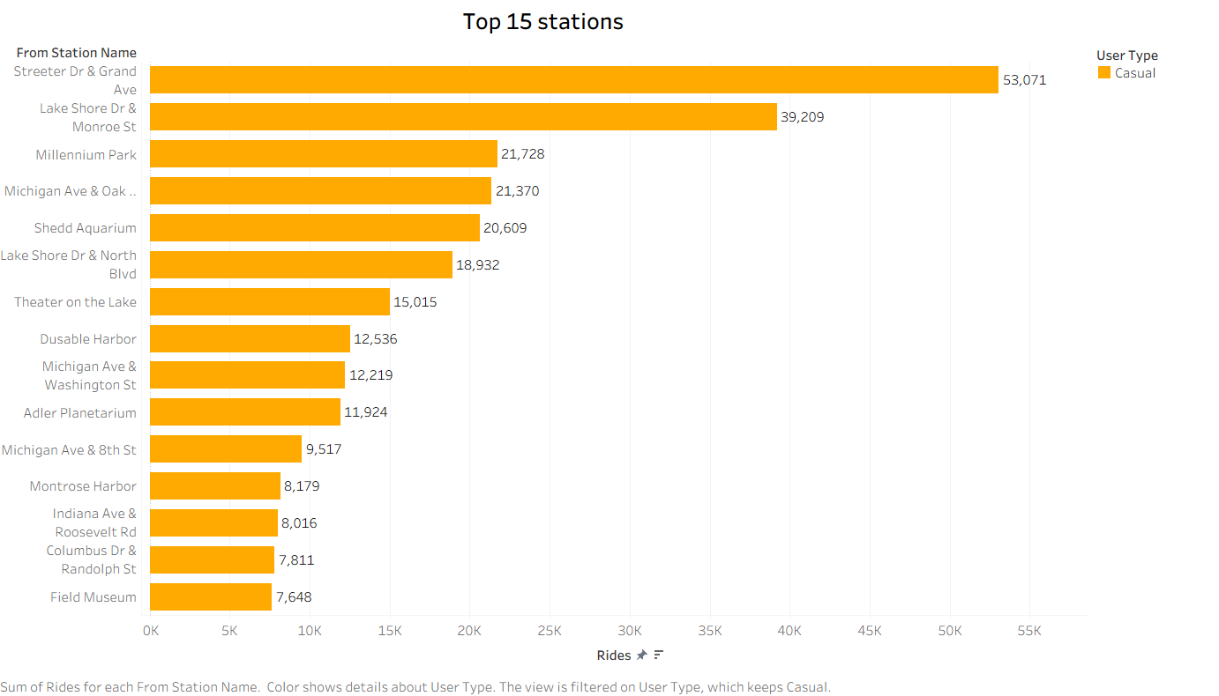
Top 15 stations
These are the top 15 stations among the 640 stations, ranked by casual-rider activity.
Casual riders at this stations can be surveyed to get more information on their preferences.

Slide 9
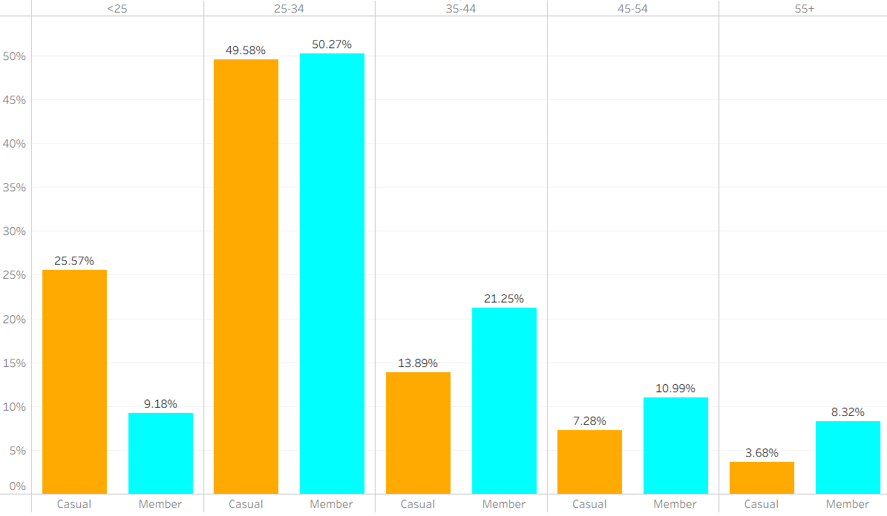
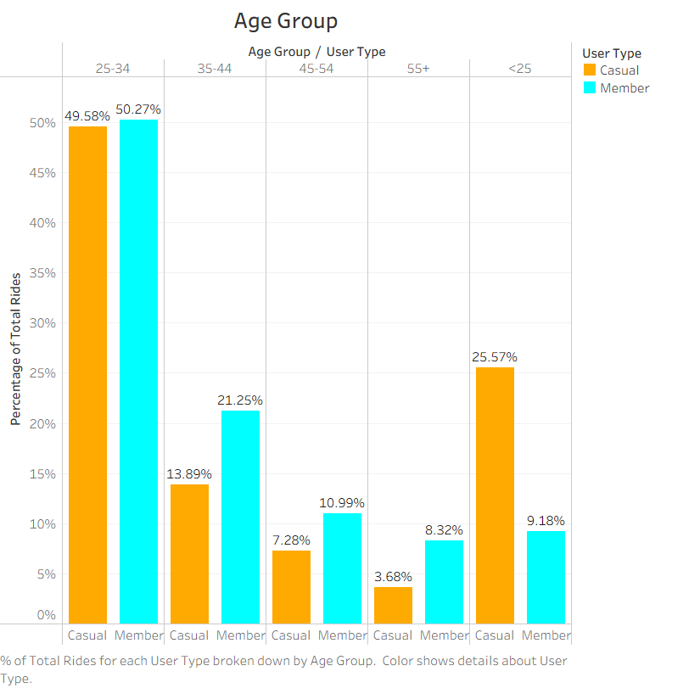
Age groups
Riders Under 25s are 2.8× more common among casual riders (25.6% vs. 9.2% of rides)
The 25-34 group is the largest in both user groups accounting for approximately 50% of each group.

Slide 10
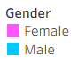
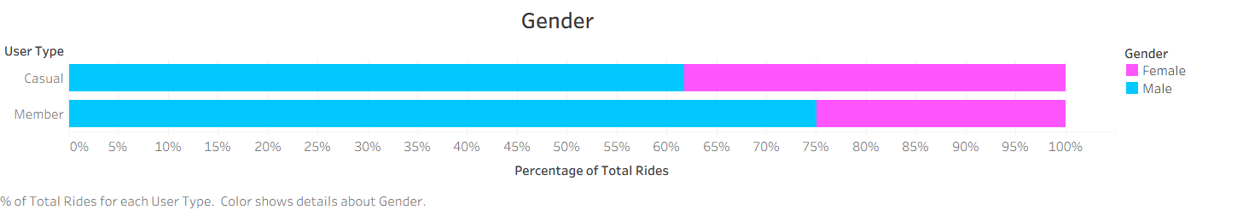
gender
Men account for 62% of casual riders and 76% of members, making them the majority in both groups.
Campaigns should be informed by these demographic patterns, while testing whether different messages appeal to different customer segments.

Slide 11
conclusions
01.
02.
03.
Market Cyclistic as a daily transportation option, highlighting commuting and everyday errands to casual riders who currently use the bikes mostly for leisure.
Focus marketing campaigns and promotional events on the summer season and on the top 15 casual-rider stations, where most casual riders activity is concentrated.
Focusing on summer season and top 15 stations does not mean ignore all the other seasons and stations.
Create member-only events, such as group rides, races, and social meetups, aimed at the under-35 riders who make up most of the casual riders base, and promote membership as the way in.
All the evens must not be only for member-only some events can be, free entry for both type of users to show casual riders what are the benefit of a membership.

Slide 12
Any Questions
Thank
You

